Slide 1
Synopsis for Final Year Project “Deep Learning Based Detection of Depression”
Project Team Guide
Akshay Suryanarayan Hegde Prof. Ashritha R. Murthy
Ganesh S
Aniket Kharad
Manzoor Ahmed

Slide 2
Introduction
Existing Solution
The existing solution is based on taking the dataset, applying feature extraction and implementing some ML and DL models.
Proposed Solution
The proposed solution is based on the following
Dataset is retrieved by using Automation on Twitter using TWINT
Data is cleaned and features are extracted using NLP
Machine Learning Models are applied like Random Forest, Naïve Bayes
Deep Learning Models are applied using CNN, CNN + LSTM, CNN + GRU
Result is analysed with various metrics of accuracy

Slide 3
Literature Review
Jana M. Havigerova et.al methodology emphasis more on quantitaive lingustic charateristics which are suited based on pronominalisation index and readiness to action index in men and sentence complexity and punctuation for women. Making use of this peculiar feature of Text the author has proposed various models.
Tejus R. S. et.al proposed possible CNN + LSTM model and other machine learning models to find stressful tweets from different kinds of datasets. As the paper was under research during early stages of pandemic, it includes comparative study between the stress level and local demographic level disaster against before and during initial days of pandemic. Where it is found out that strees level indicating stress lvels had risen by 30 times where as diaster related by 10 times.

Slide 4
Dataset
There are two datasets used which are as follows
Sample_Dataset.csv from Kaggle which is a huge corpa of tweets
Other dataset is a collection of datasets of various depressive syndromes like depression.csv, PTSD.csv, stress.csv etc.
The latter dataset was extracted using Automation with the help of TWINT tool.

Slide 5
Objectives Accomplished
Collected the data from Twitter using Automation and analyzed the data.
Cleaned the raw data and extracted features from the data.
Converted the features into a matrix which could be easily fed into algorithms for training purposes.
Applied Machine Learning and Deep Learning Models for training purposes.
Comparative analysis of the results sought and visualization of the output.

Slide 6
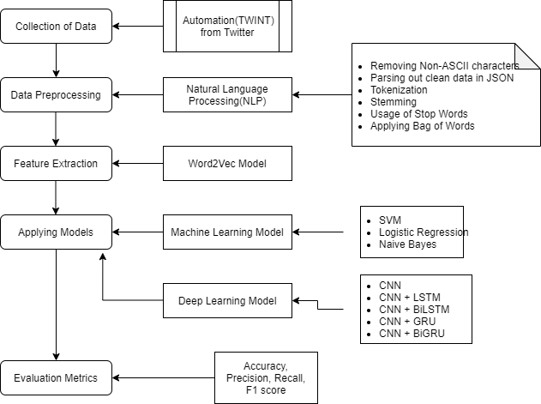
System Design and Implementation

Slide 7
System Design and Implementation(cont)
Deep Learning Models used are
CNN
CNN + LSTM
CNN + Bidirectional LSTM
CNN + GRU
CNN + Bidirectional GRU
These models are used with exhaustive set of activation functions, epochs, Learning rate, training set and testing set.

Slide 8
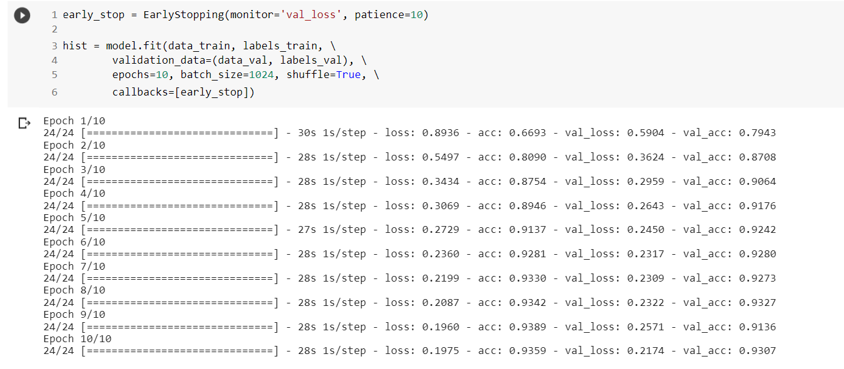
System Design and Implementation(cont)

Slide 9
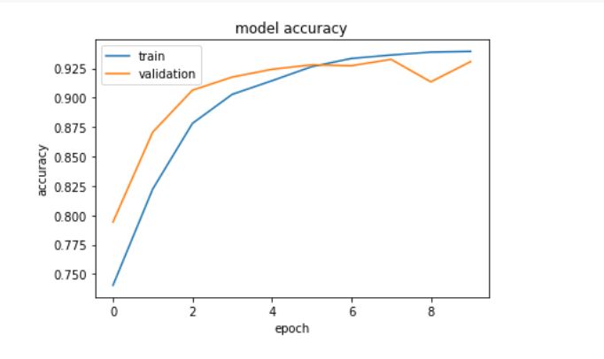
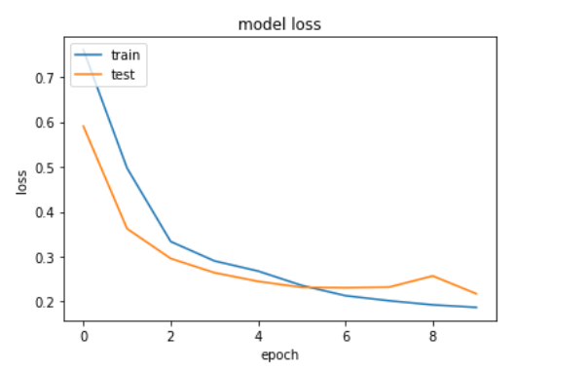
System Testing and Result Analysis

Slide 10
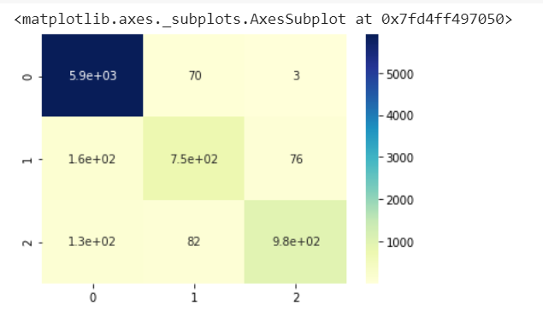
System Testing and Result Analysis
Model | Accuracy | Loss
Naïve Bayes | 75.99
Random Forest | 85.28
CNN | 94.81 | 0.1683
CNN + LSTM | 94.32 | 0.1736
CNN + BiLSTM | 94.54 | 0.1763
CNN + GRU | 94.81 | 0.1630
CNN + BiGRU | 94.79 | 0.1729

Slide 11
Thank You

